Slide 1

Course code : CSE3009 Course title : No SQL Data Bases Module : 6 Topic : 2
Neo4j DB Introduction

Slide 2
Objectives
This session will give the knowledge about
Neo4j Introduction
Neo4j Windows Installation

Slide 3
Neo4j History
Neo4j is the world's leading open source Graph Database which is developed using Java technology. It is highly scalable and schema free (NoSQL).
Nowadays, most of the data exists in the form of the relationship between different objects and more often, the relationship between the data is more valuable than the data itself.
Relational databases store highly structured data which have several records storing the same type of data so they can be used to store structured data and, they do not store the relationships between the data.

Slide 4
RDBMS Vs Graph Database
Following is the table which compares Relational databases and Graph databases.
Sr.No | RDBMS | Graph Database
1 | Tables | Graphs
2 | Rows | Nodes
3 | Columns and Data | Properties and its values
4 | Constraints | Relationships
5 | Joins | Traversal

Slide 5
Advantages of Neo4j
Flexible data model − Neo4j provides a flexible simple and yet powerful data model, which can be easily changed according to the applications and industries.
Real-time insights − Neo4j provides results based on real-time data.
High availability − Neo4j is highly available for large enterprise real-time applications with transactional guarantees.
Connected and semi structures data − Using Neo4j, you can easily represent connected and semi-structured data.

Slide 6
Advantages of Neo4j
Easy retrieval − Using Neo4j, you can not only represent but also easily retrieve (traverse/navigate) connected data faster when compared to other databases.
No joins − Using Neo4j, it does NOT require complex joins to retrieve connected/related data as it is very easy to retrieve its adjacent node or relationship details without joins or indexes.

Slide 7
Features of Neo4j
Data model (flexible schema) − Neo4j follows a data model named native property graph model. Here, the graph contains nodes (entities) and these nodes are connected with each other (depicted by relationships).
In Neo4j, there is no need to follow a fixed schema. You can add or remove properties as per requirement. It also provides schema constraints.
ACID properties − Neo4j supports full ACID (Atomicity, Consistency, Isolation, and Durability) rules.

Slide 8
Features of Neo4j
Scalability and reliability − You can scale the database by increasing the number of reads/writes, and the volume without effecting the query processing speed and data integrity. Neo4j also provides support for replication for data safety and reliability.
Cypher Query Language − Neo4j provides a powerful declarative query language known as Cypher. It uses ASCII-art for depicting graphs.
Cypher is easy to learn and can be used to create and retrieve relations between data without using the complex queries like Joins.

Slide 9
Features of Neo4j
Built-in web application − Neo4j provides a built-in Neo4j Browser web application. Using this, you can create and query your graph data.
Drivers − Neo4j can work with:
REST API to work with programming languages such as Java, Spring, Scala etc.
Java Script to work with UI MVC frameworks such as Node JS.
It supports two kinds of Java API
Indexing − Neo4j supports Indexes by using Apache Lucence.

Slide 10
Neo4j Property Graph Data Model
Neo4j Graph Database follows the Property Graph Model to store and manage its data. Following are the key features of Property Graph Model −
The model represents data in Nodes, Relationships and Properties
Properties are key-value pairs
Nodes are represented using circle and Relationships are represented using arrow keys
Relationships have directions: Unidirectional and Bidirectional. Each Relationship contains "Start Node" or "From Node" and "To Node" or "End Node"
Both Nodes and Relationships contain properties. Relationships connects nodes

Slide 11
Neo4j Property Graph Data Model
In Property Graph Data Model, relationships should be directional. If we try to create relationships without direction, then it will throw an error message.
In Neo4j too, relationships should be directional. If we try to create relationships without direction, then Neo4j will throw an error message saying that "Relationships should be directional".
Neo4j Graph Database stores all of its data in Nodes and Relationships. We neither need any additional RRBMS Database nor any SQL database to store Neo4j database data. It stores its data in terms of Graphs in its native format.

Slide 12
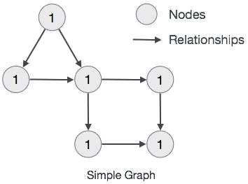
Neo4j Property Graph Data Model
Neo4j uses Native GPE (Graph Processing Engine) to work with its Native graph storage format.
The main building blocks of Graph DB Data Model are:
Nodes
Relationships
Properties
Following is a simple example of a Property Graph.

Slide 13

Neo4j DB Server Setup with Windows exe File
Follow the steps given below to download Neo4j into your system.
Step 1 − Visit the Neo4j official site using https://neo4j.com/. On clicking, this link will take you to the homepage of neo4j website.

Slide 14
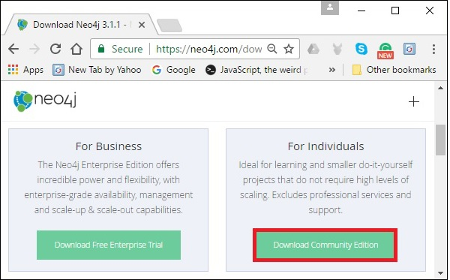
Neo4j DB Server Setup with Windows exe File
Step 2 − As highlighted in the above screenshot, this page has a Download button on the top right hand side. Click it.
Step 3 − This will redirect you to the downloads page, where you can download the community edition and the enterprise edition of Neo4j. Download the community edition of the software by clicking the respective button.

Slide 15
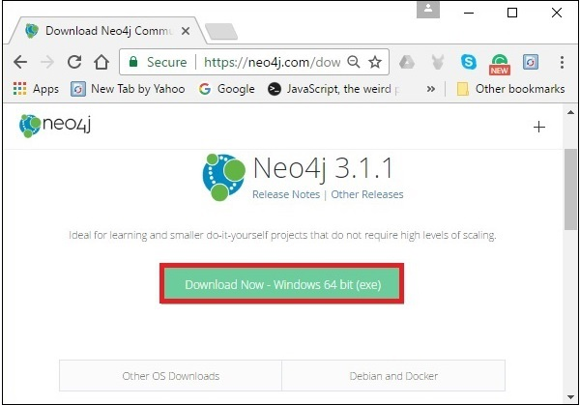
Neo4j DB Server Setup with Windows exe File
Step 4 − This will take you to the page where you can download community version of Neo4j software compatible with different operating systems. Download the file respective to the desired operating system.

Slide 16
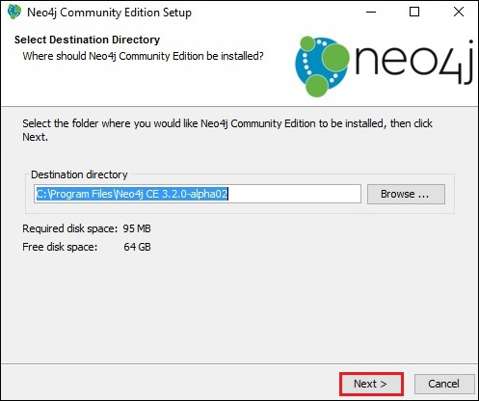
Neo4j DB Server Setup with Windows exe File
Step 5 − Double-click the exe file to install Neo4j Server.

Slide 17
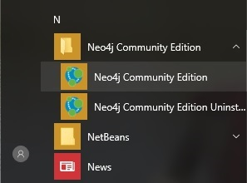
Starting the Server
Step 6 − Accept the license agreement and proceed with the installation. After completion of the process, you can observe that Neo4j is installed in your system.
Starting the Server
Step 1 − Click the Windows startmenu and start the Neo4j server by clicking the start menu shortcut for Neo4j.

Slide 18
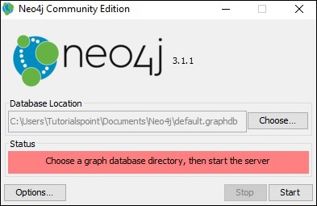
Starting the Server
Step 2 − On clicking the shortcut, you will get a window for Neo4j Community edition. By default, it selects c:\Users\[username]\Documents\Neo4j\default.graphdb. If you want, you can change your path to a different directory.

Slide 19
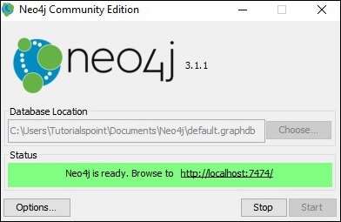
Starting the Server
Step 3 − Click the "Start" button to start the Neo4j server.

Slide 20
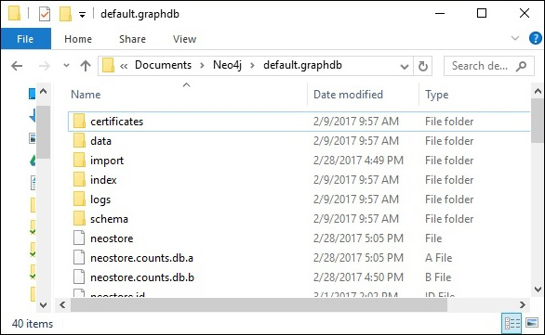
Starting the Server
Once the server starts, you can observe that the database directory is populated as shown in the following screenshot.

Slide 21
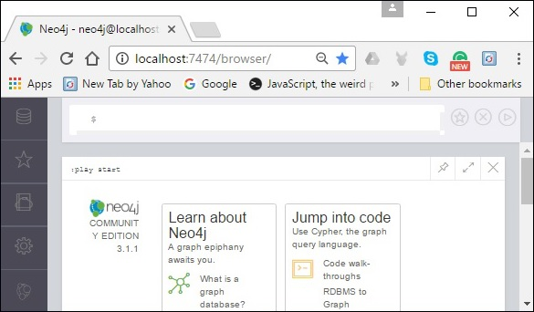
Working with Neo4j
As discussed in the previous chapters, neo4j provides an in-built browse application to work with Neo4j. You can access Neo4j using the URL http://localhost:7474/

Slide 22
Summary
This session will give the knowledge about
Neo4j Introduction
Neo4j Windows Installation

